Slide 1
Image Preprocessing Tool
20XX
Nilay Patel
Harsh Baheti
Anshul Agarwal
Jai Samir Modi

Slide 2
Introduction
The “Image Preprocessing Tool” is a powerful aid to beginners into photo editing. This tool aids the user with multiple preprocessing tasks, including, but not limited to, improving contrast, Image Sharpening. This can be further used by professionals in several fields who do not have in depth knowledge of image processing.

Slide 3
Methodology
A UI built in python to compile the various image preprocessing methods
Image brightness increase and decrease
Adding a predefined value to all the pixels in the image to increase the brightness of the image, and subtracting the said value for the opposite effect
Using addition and subtraction mathematical operators as it provides a greater extent of control over the changes than multiplication and division.

Slide 4
Methodology
2. Image Blurring
Using median blur filter upon the entire image. The level of blurring is achieved by manipulating the size of the kernel. As per testing, the size of kernel can range between 1-99, 1 being the original image.

Slide 5
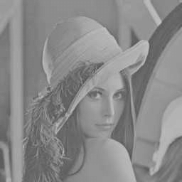
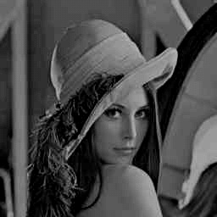
Methodology
3. Contrast adjustment
The image is first split into its color space, namely BGR and the calculations are applied on each channel, where the intensity is increased by a certain amount (Controlled by the slider).

Slide 6
Methodology
4. Image sharpening
The process starts same as others, the image is broken down into its channels, namely BGR and a built in method of addWeightes is applied on each channels. This method multiplies the original image by 1+amount of sharpening and subtracts the blurred image of the original inorder to reintroduce some high frequency information.

Slide 7
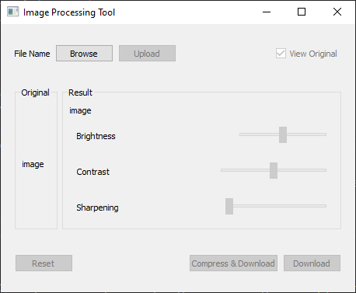
Methodology Tech Stack
. Python
. OpenCV
. PyQt5
. QtDesigner
source Code

Slide 8
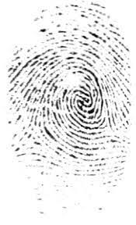
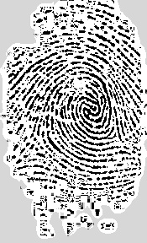
Real Life Applications
For real life applications, This product can be used as a preprocessing tool for image processing. This product provides high controllability in the hands of the user with regards the the 3 application currently applied. As tested, this application can be used for forensic purposes, as it works well with fingerprints and signatures.
Notes:
The product also allows image compression at the time of downloading, which in the background uses huffman coding. The relative ratio of compression as per testing has come out as <value>

Slide 9
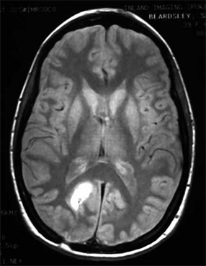
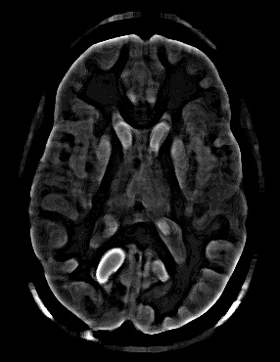
Real Life Applications - medical

Slide 10
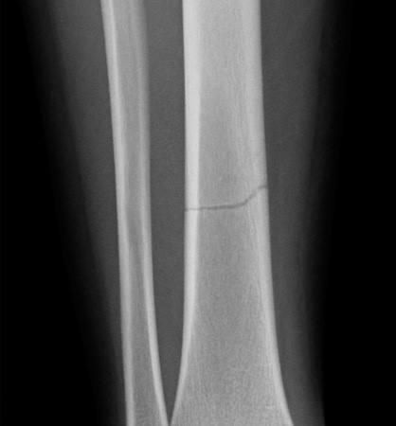
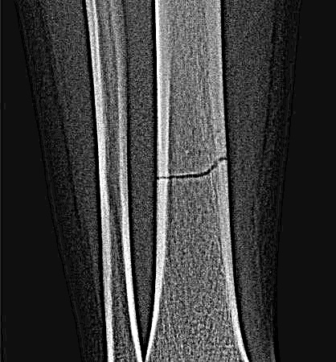
Real Life Applications - medical

Slide 11
Future Work
The methods applied currently are crude and has some rough edges to be cut down. For future work, the application of further preprocessing methods, and combinations of such tool can be applied.
For the case of image compression, application of Huffman coding to provide the users with the ability of image compression.

Slide 12
Thank You

